Slide 1







My Favourite Village
A presentation product by group 2

Slide 2

Members
1.LÊ THỊ KIỀU ANH
2.TRẦN CHẤN PHONG
3.NGUYỄN TRẦN PHƯƠNG UYÊN
4.ĐỖ ĐÌNH ANH VŨ
5. NGUYỄN TRẦN BẢO AN
6. ĐẶNG MINH QUÂN
7.NGUYỄN VĂN DUY PHÚ
8.NGUYỄN THỊ TƯỜNG VÂN
9.ĐẶNG TUẤN KIỆT
10.LÊ NGUYỄN PHƯƠNG KHÁNH
11.NGUYỄN NGỌC BẢO TRÂM
12.NGUYỄN TRẦN ANH DUY

Slide 3



Tuy Loan Ancient Village
Tuy Loan Ancient Village is located in Hoa Vang, Da Nang. This historic village is more than 500 years old.
People and Activities:
The Scenery
It has a peaceful view near the river, with an old banyan tree and an ancient communal house.
The local people here are exceptionally friendly. They are famous for making delicious traditional food and high-quality rice paper. Every year, the village hosts a big festival that attracts many visitors.

Slide 4


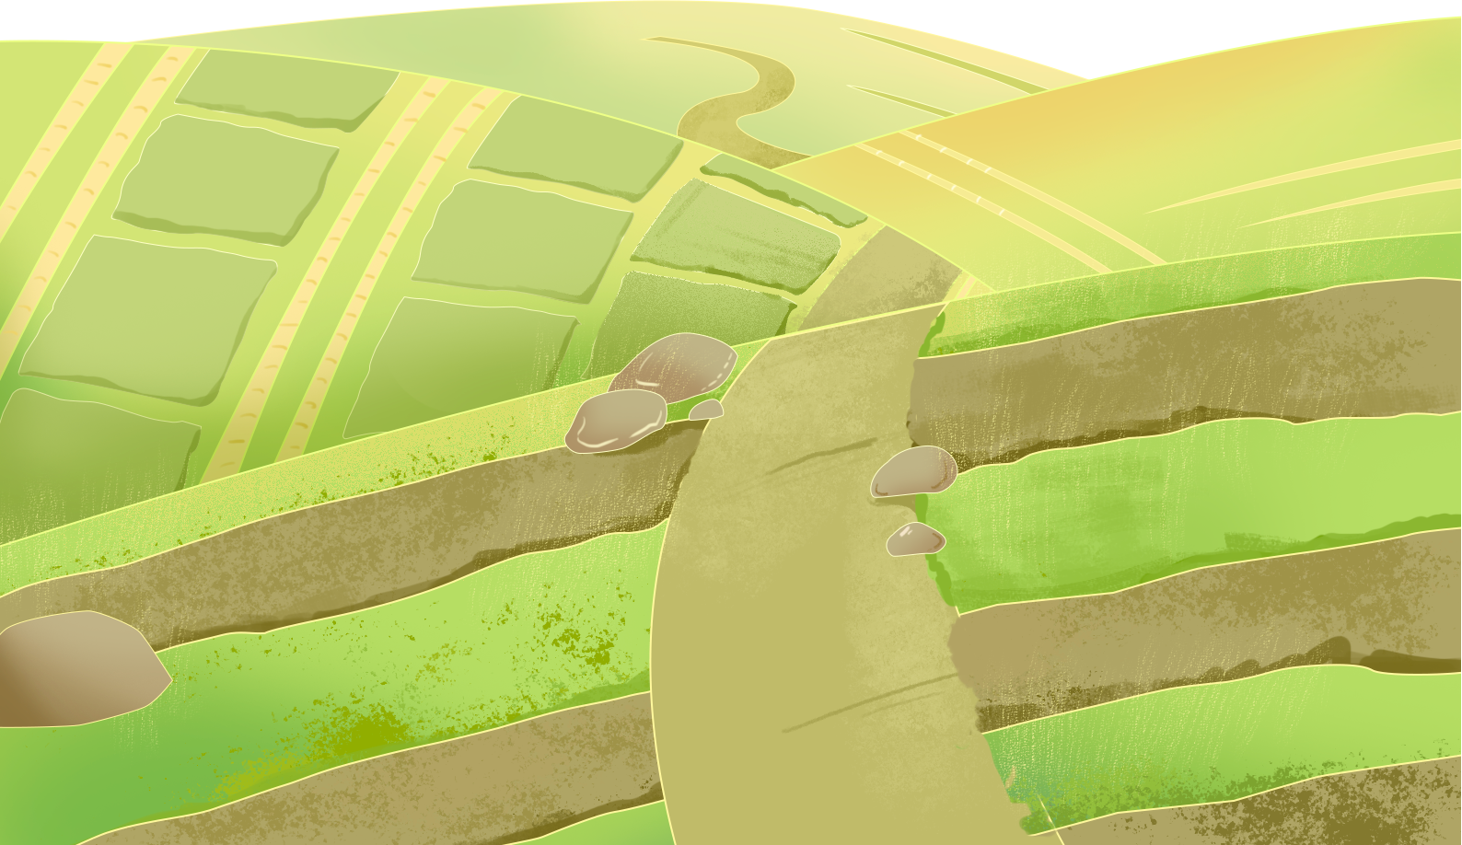
Non Nuoc Stone Village
Name and Location:
People and Activities:
Scenery:
Skilled artists use stone to carve amazing statues of animals and people. Tourists love to visit and buy nice souvenirs here.
Non Nuoc Stone Village is at the foot of the Marble Mountains in Da Nang.
It is a lively village next to the beautiful mountains.

Slide 5


Cam Ne Mat Village
Name and Location:
Cam Ne Mat Village is in Hoa Vang, Da Nang.
It is a quiet and peaceful countryside. You can see colorful mats drying outside the houses.
Scenery:
The villagers are very good at weaving mats. Cam Ne mats are thick, soft, and strong. People here are proud to keep this traditional job alive.
People and Activities:

Slide 6
Phong Nam Ancient Village
Phong Nam Ancient Village is a century-old sanctuary just 10 km from Da Nang, preserving the pristine soul of Central Vietnam’s countryside. Behind its iconic moss-covered brick gate lies a nostalgic world of ancient communal houses, winding alleys, and serene rice fields. It is a timeless escape to experience rich history, rustic architecture, and a beautifully slow pace of life.

Slide 7

Please be patient and wait, It don’t take much time
GROUP 2
Presentation topic
My Favourite Village
Content
Tuy Loan Ancient Village
Non Nuoc Stone Village
Cam Ne Mat Village
Phong Nam Ancient Village
Group leader
Nguyễn Trần Bảo An
Team leader
Đỗ Đình Anh Vũ
Informant
Lê Thị Kiều Anh
Nguyễn Trần Phương Uyên
Nguyễn Trần Bảo An
slide editor
Đỗ Đình Anh Vũ (highest level of participation)
Trần Chấn Phong
Nguyễn Trần Phương Uyên
Present
All members
THANK YOU FOR LISTENING
Please share your comments

